Slide 1
CHAPTER 3 & 4 The Conversion Story

Slide 2
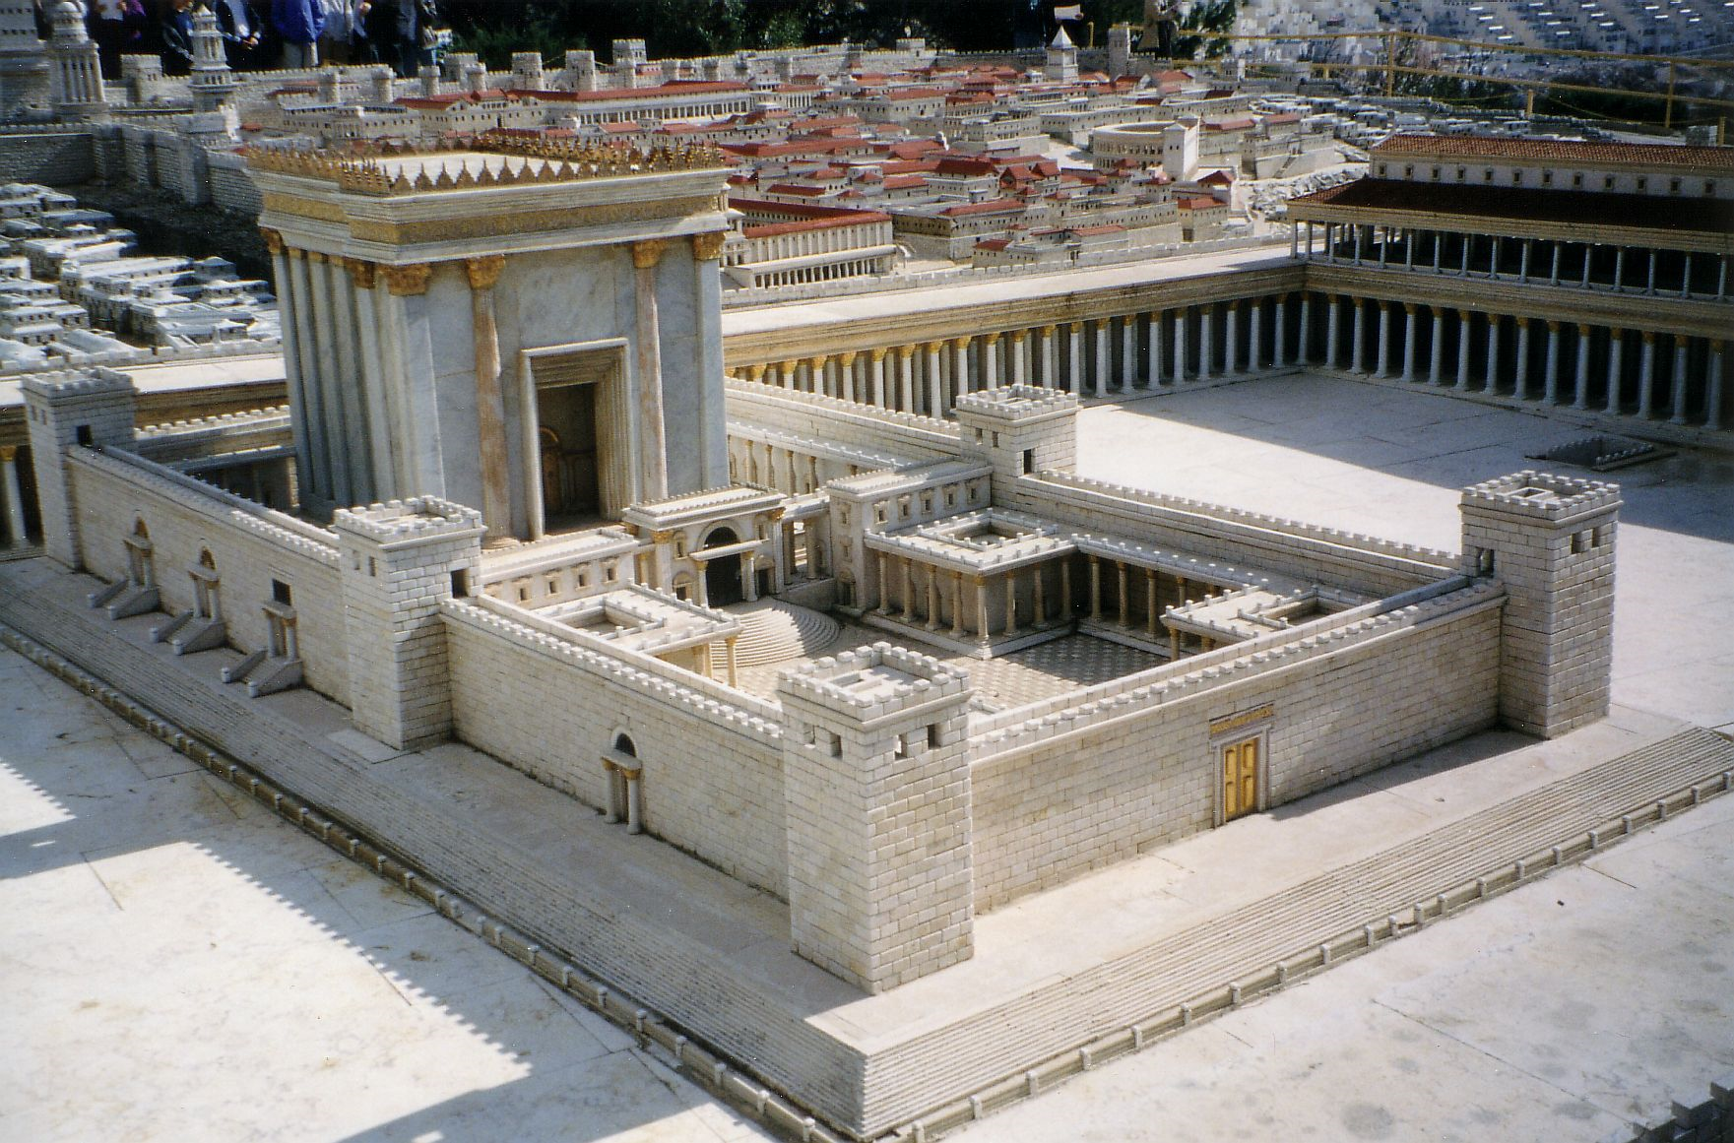

Slide 3
Acts 3:4-6
“And Peter, fastening his eyes upon him with John, said, Look on us. And he gave heed unto them, expecting to receive something of them.
Vs. 6, “Then Peter said, Silver and gold have I none; but such as I have given I thee: In the name of Jesus Christ of Nazareth rise up and walk.”

Slide 4
THE FAITH REACTION
Acts 3:15
Acts 3:19, “Repent ye therefore, and be converted, that your sins may be blotted out, when the times of refreshing shall come from the presence of the Lord;”
The number of believing men was 5,000

Slide 5
A NEGATIVE REACTION
Peter and John were arrested
Their arguments were stellar!
Prayers for courage to preach the gospel

Slide 6
CONSIDER THE FOLLOWING
Those in the Temple were spiritually lost
Faith made the crippled man strong
The faith of Peter and John

Slide 7
Are You Living The
Conversion Story Today?

