Slide 1
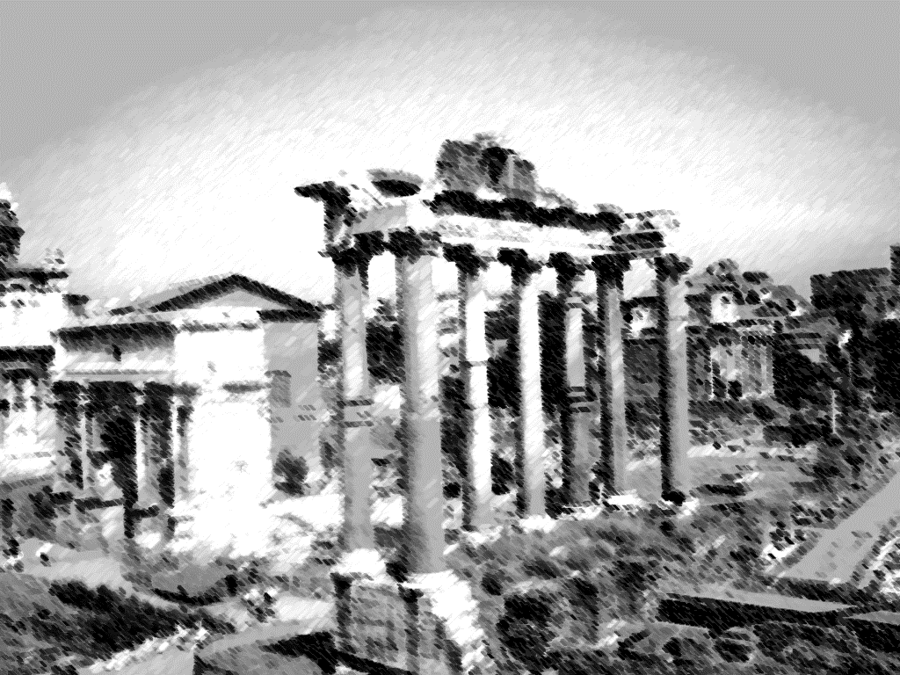
BABYLON IS FALLEN

Slide 2
Genesis 6:7
“And the Lord said, I will destroy man whom I have created, from the face of the earth; both man, and beast, and the creeping thing, and the fowls of the air; for it repenteth me that I have made them.”

Slide 3
WHAT WAS WRITTEN?
Spiritual Harlot
Sitting upon a scarlet colored beast
Garments of purple and scarlet
Drunk with the blood of saints/martyrs
Angel explained to John

Slide 4
WHAT COULD THIS MEAN?
City of Jerusalem?
Roman Catholic Church?
Revelation 1:1
Rome and the Empire
“Nero Revived?”
“The Melting Pot”

Slide 5
LESSONS FOR US?
Our Lord Forever Reigns
Those in Christ:
Called
Chosen
Faithful

Slide 6
God’s Ultimate Judgment Will One Day Come Upon The Entire World

