Slide 1
THE BEASTS AND THE MARK
Revelation 13

Slide 2
PICTURE THE SCENE
Beast Rising From The Sea
7 Heads
10 Horns
Crowns
Name of Blasphemy
Animalistic Features

Slide 3
THE 2nd BEAST
The Beast Rising From The Earth
2 horns like a Lamb
Enforced Worship Of The First Beast
Fear
Magic
Economic Pressure

Slide 4
WHAT IS UNDER CONSIDERATION?
1st Beast Domitian
“Dominus et deus”
The Days of Nero
Revelation 13:3, “And I saw one of his heads
as it were wounded to death; and his deadly
wound was healed: and all the world wonder-
ed after the beast.”

Slide 5
THE EMPEROR WASN’T ALONE
2ND Beast “The False Prophet”
Built Images of Domitian
Magic To Deceive the population
Prevented “unbelievers” to buy and sell

Slide 6
666 THE MARK OF THE BEAST
Nero
Domitian
Roman Catholic Church - Pope

Slide 7
MARK OF THE BEAST???
1941
Numbering System starting with 100
“A” for 100, “B” for 101, “C” for 102, etc.
TOTAL: 666 - HITLER

Slide 8
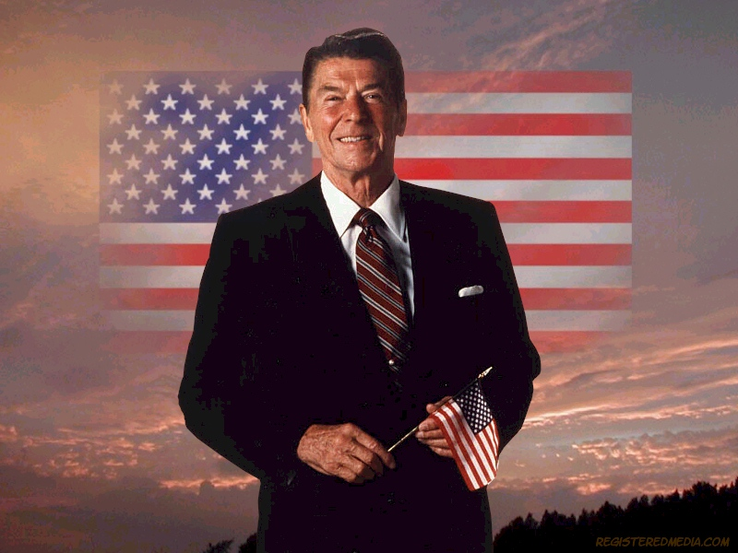
MARK OF THE BEAST???
1ST Name - 6 letters
Middle - 6 letters
Last Name - 6 letters
666 – Ronald Wilson Reagan

Slide 9
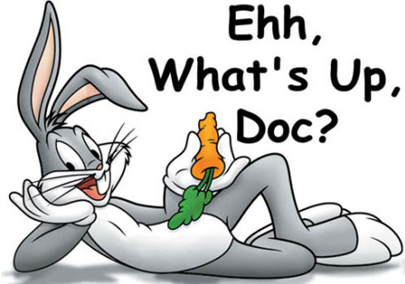
MARK OF THE BEAST???
1940 Leon Schlesinger
RABBIT – 6 letters
CARROT – 6 letters
VOICES - 6 letters

Slide 10
LESSONS FOR US?
We Are Blessed To Live In This Country
Satan Will Find Many To Do His Bidding
Be Numbered Among The Faithful
Have You Been Washed In The
Blood Of The Lamb?

