Slide 1
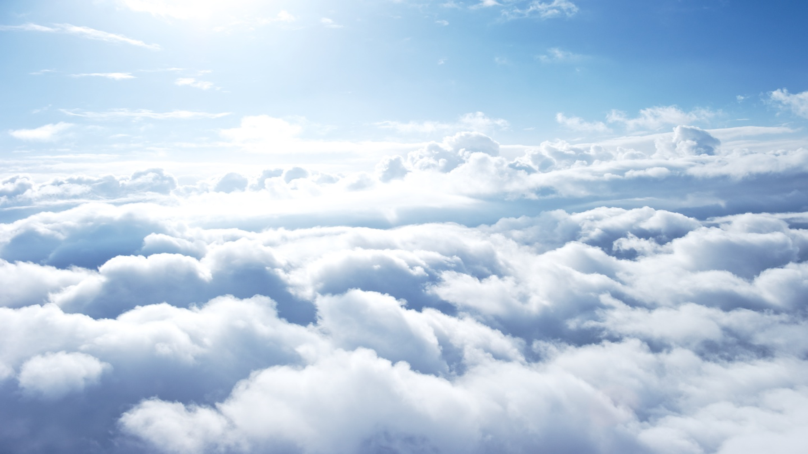
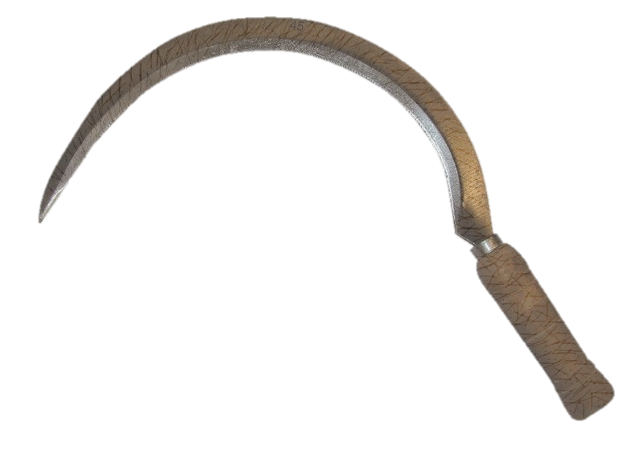
THE LAMB OF GOD
Revelation 14

Slide 2
THE ALLIES OF GOD
The Lamb at Mt. Zion
Hebrews 12:22
144,000 Belong To God
The Great and Wonderful Voice
To God Be Honor And Glory

Slide 3
God’s Promise
Babylon Is Fallen
Those Who Follow The Beast Would Also
Endure The Judgment of God
“Blessed are the dead who die in the Lord from henceforth: Yea, saith the Spirit, that they may rest from their labors; and their works
do follow them.”

Slide 4
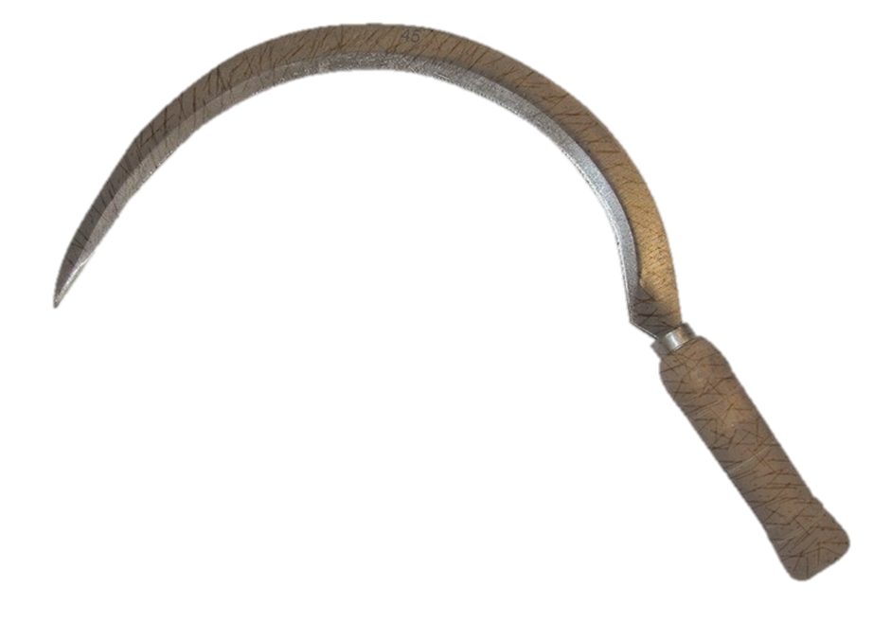
JUDGMENT
2 Scenes:
The Harvest of the earth
The Harvest of the Grapes
The Winepress Of Blood

Slide 5
LESSONS FOR US
God Knows Us
God Provides For Us
Is There A Land Of Rest
Waiting For You?

