Slide 1
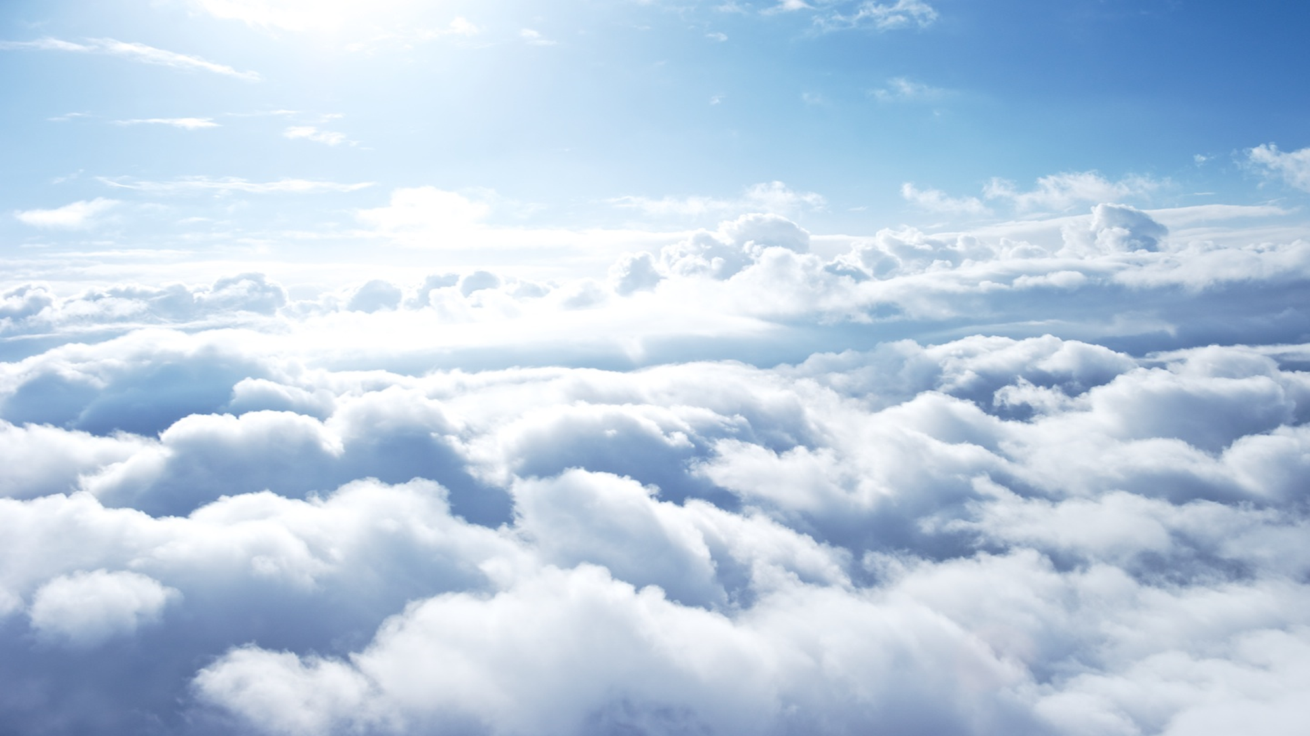
DOXOLOGY TO THE LORD GOD ALMIGHTY
Revelation 15

Slide 2
WHAT DID JOHN SEE?
7 Angels 7 Plagues
Sea of Glass Mingled With Fire
7 Bowls
Temple Filled With Smoke

Slide 3
WHAT COULD THIS MEAN?
Total Judgment On Rome
“How long, O Lord, holy and true, dost thou not judge and avenge our blood on them that dwell on the earth?”
Angels Were Given The Wrath

Slide 4
Revelation 15
Theme Of Divine Deliverance
“Who shall not fear thee, O Lord, and glorify Thy name? For thou only art holy..”
“Who is like unto the beast? Who is able to make war with him?”

Slide 5
Will you be found washed in the cleansing power of the Lamb?

