Slide 1
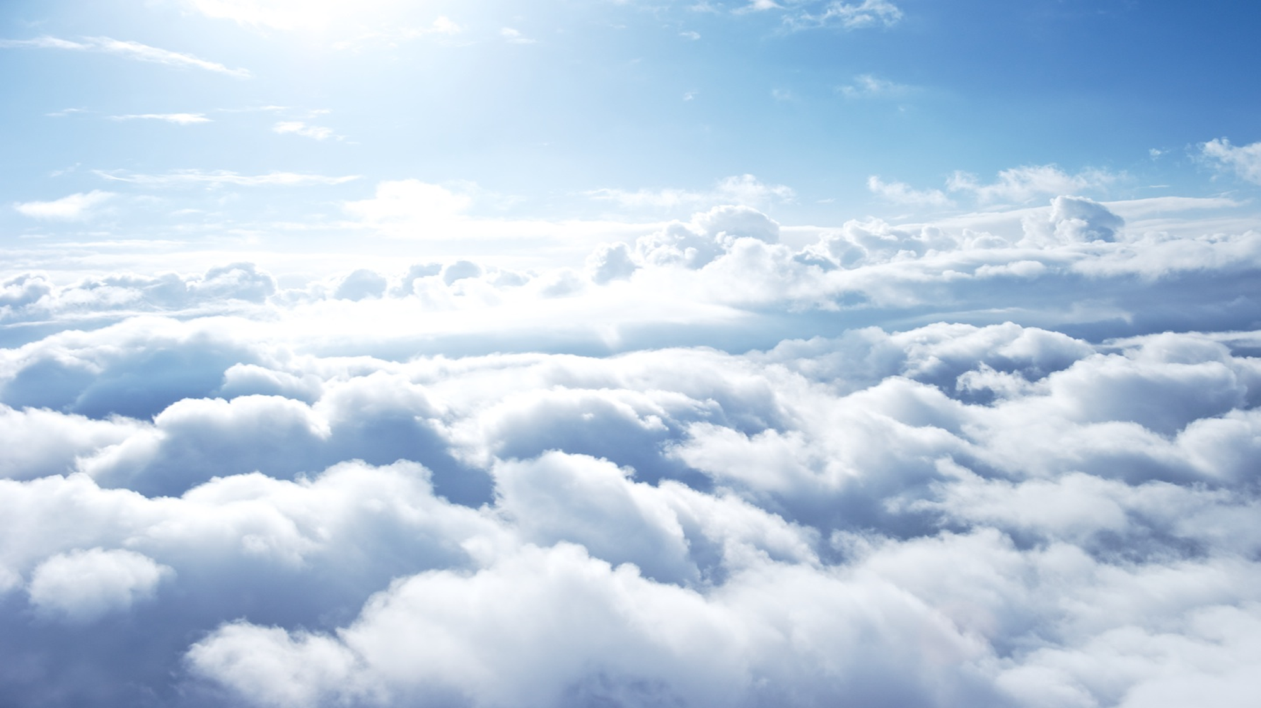
THE BOWLS OF GOD
Revelation 16

Slide 2
WHAT IS PICTURED?
Sore appeared upon those of the Beast
Sea turned to blood
Rivers and Fountains turned to blood
Sun scorched with fire
Kingdom went dark with suffering
Euphrates dried up

Slide 3
WHAT IS PICTURED?
Frogs from the mouth of the Dragon
Gathered at Armageddon
7th Angel announced it is finished
The nations fell

Slide 4
WHAT COULD THIS MEAN?
A book of symbolism
God’s full and perfect wrath
Like the plagues of Egypt
Religious propaganda during that
governmental decline

Slide 5
WE SHOULD BE MINDFUL
II Peter 3:10, “But the day of the Lord will come as a thief in the night; in which the heavens shall pass away with a great noise, and the elements shall melt with fervent heat, the earth also and the works that are therein shall be burned up.”

Slide 6
FINAL JUDGMENT IS COMING
Will We Be
Ready For That Day?

