Slide 1
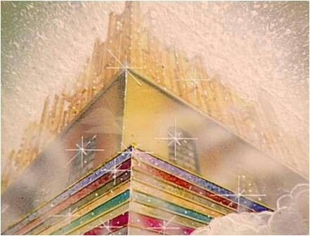
THE JUDGMENT AND THE FAITHFUL OF GOD
Revelation 20:11-22:7

Slide 2
THE JUDGMENT DAY
White Throne
The Dead Stand Before God
The Books And The Book Of Life
Those Not Found In The Book Of Life

Slide 3
THE JUDGMENT THEN WHAT?
Earth will be destroyed (I Peter 3:10)
New dwelling place
John 14:2-3, “In my Father’s house are many mansions:
if it were not so, I would have told you. I go to prepare
a place for you. And if I go and prepare a place for you,
I will come again, and receive you unto Myself; that
where I am, there ye may be also.”
“New Jerusalem” – The Glorified Church in Heaven!

Slide 4
THE WONDERFUL HEAVENLY BRIDE
Surrounded By The Power Of God
Bright As Diamonds!
High Walls – Never Conquered
Gates – 12 Tribes Of Isreal
Foundations – Apostles Work

Slide 5
THE WONDERFUL HEAVENLY BRIDE
Measuring Of The City
Gates – Made Of Pearls
No Need For A Temple
No Need For Sun Or Moon
No Other Glories Can Compare

Slide 6
THE PROVISIONS FOR THE SAINTS
Water Of Life
Tree Of Life
Healing Leaves
We Shall See His Face!
“Behold I Come Quickly”

Slide 7
HOW BEAUTIFUL HEAVEN MUST BE!
Have You Been
Washed In The Soul Cleansing
Blood Of The Lamb?

